Slide 1
Object Oriented Programming Lecture - 2
Prof. Dnyaneshwar Kanade

Slide 2
Different ways to create objects
There are five different ways to create an object in Java:
Java new Operator
Java Class.newInstance() method
Java newInstance() method of constructor
Java Object.clone() method
Java Object Serialization and Deserialization

Slide 3
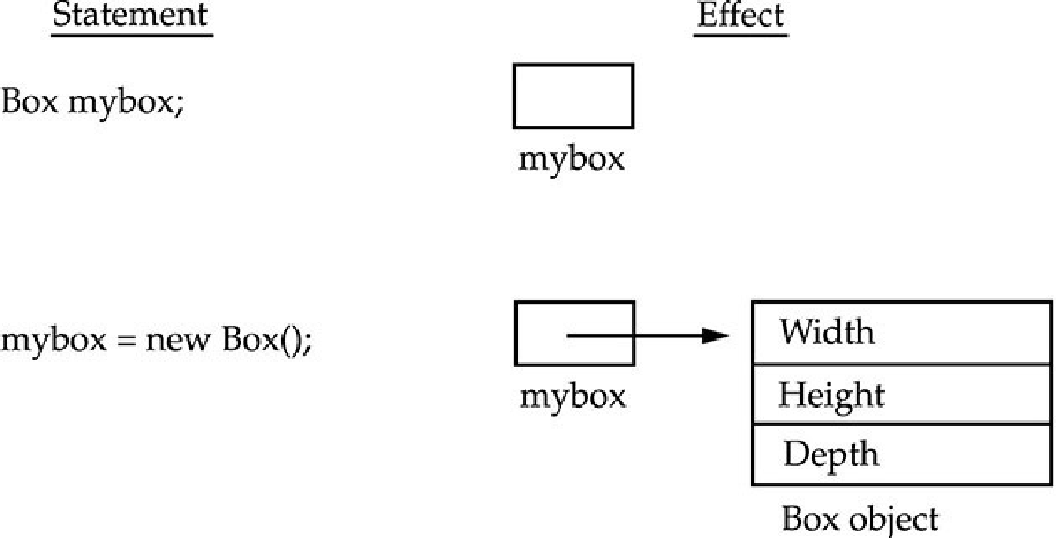
Different ways to create objects
1) Java new Operator
This is the most popular way to create an object in Java.
A new operator is also followed by a call to constructor which initializes the new object.
While we create an object it occupies space in the heap.

Slide 4
Different ways to create objects
1) Java new Operator
new allocates memory for an object during run time.
The advantage of this approach is that your program can create as many or as few objects as it needs during the execution of your program.
If new is not able to allocate memory for an object because of insufficient memory, a run-time exception will occur.
Example

Slide 5
Different ways to create objects
2) Java Class.newInstance() method
Java Class.newInstance() is the method of Class class.
The Class class belongs to java.lang package.
It creates a new instance of the class represented by this Class object.
It returns the newly created instance of the class.
Example

Slide 6
Different ways to create objects
3) Java newInstance() method of Constructor class
Java Constructor class also has a newInstance() method similar to newInstance() method of Class class.
newInstance() method belongs to
java.lang.reflect.Constructor class.
Both newInstance() method are known as reflective ways to create object.
In fact the newInstance() method of Class class internally uses newInstance() method of Constructor class.
The method returns a new object created by calling the constructor.

Slide 7
Different ways to create objects
3) Java newInstance() method of Constructor class
The newInstance() method throws the following Exception:
IllegalAccessException: If the constructor is inaccessible.
IllegalArgumentException: If the actual and formal parameter differ in number.
InstantiationException: If the class constructor represents an abstract class.
InvocationTargetException: If the underlying constructor throws an exception.
ExceptionInInitializerError: If the initialization provoked by this method fails.
Example

Slide 8
Different ways to create objects
4) Java Object.clone() method
Java clone() method creates a copy of an existing object.
It is defined in Object class. It returns clone of this instance.
The two most important point about clone() method is:
The Cloneable interface must be implemented while using clone() method. It is defined in java.lang package.
The clone() method must override with other classes.

Slide 9

Different ways to create objects
4) Java Object.clone() method
When we use clone() method in class, the class must call super.clone() to obtain the cloned object reference.
The method throws the CloneNotSupportedException if the Object class does not support the Cloneable interface.

Slide 10
Different ways to create objects
5) Java Object Serialization and Deserialization
A class must implement Serializable interface which belongs to java.io package.
The Serializable interface does not have any method and field.
They add special behavior to the class.
JVM creates a separate space whenever we serialize and deserialize an object. It does not use any constructor to create an object.

Slide 11
Different ways to create objects
5) Java Object Serialization and Deserialization
The Serialization is a process of converting an object into a sequence of bytes.
The ObjectOutputStream class is used to serialize an object.
The writeObject() method of ObjectOutputStream class serialize an object and write the specified object to the ObjectOutputStram class.
The method accepts an object as a parameter.

Slide 12
Access Modifiers
Encapsulation links data with the code that manipulates it.
However, encapsulation provides another important attribute: access control.
Through encapsulation, we can control what parts of a program can access the members of a class.
By controlling access, we can prevent misuse.
For example, allowing access to data only through a well-defined set of methods, we can prevent the misuse of that data.
Thus, when correctly implemented, a class creates a “black box” which may be used, but the inner workings of which are not open to tampering.

Slide 13
Access Modifiers
How a member can be accessed is determined by the access modifier attached to its declaration.
Java’s access modifiers are:
public,
private,
protected.
Java also defines a default access level.
protected applies only when inheritance is involved.

Slide 14
Access Modifiers
Private: The access level of a private modifier is only within the class. It cannot be accessed from outside the class.
Default: The access level of a default modifier is only within the package. It cannot be accessed from outside the package. If you do not specify any access level, it will be the default.
Protected: The access level of a protected modifier is within the package and outside the package through child class. If you do not make the child class, it cannot be accessed from outside the package.
Public: The access level of a public modifier is everywhere. It can be accessed from within the class, outside the class, within the package and outside the package.

Slide 15
Access Modifiers
Public:
When a member of a class is specified by public, then that member can be accessed by any other code.
The access level of a public modifier is everywhere.
It can be accessed from within the class, outside the class, within the package and outside the package.
main() has always been preceded by the public modifier.
It is called by code that is outside the program—that is, by the Java run-time system.

Slide 16
Access Modifiers
Private:
If a method or variable is marked as private (has the private access modifier assigned to it), then only code inside the same class can access the variable, or call the method.
Code inside subclasses cannot access the variable or method, nor can code from any external class.
Example

Slide 17
Accessing private Fields via Accessor Methods
Private:
Fields are often declared private to control the access to them from the outside world.
In some cases the fields are truly private, meaning they are only used internally in the class.
In other cases the fields can be accessed via accessor methods (e.g. getters and setters).
Example

Slide 18
Access Modifiers
Default:
The default Java access modifier is declared by not writing any access modifier at all.
The default access modifier means that code inside the class itself as well as code inside classes in the same package as this class, can access the class, field, constructor or method which the default access modifier is assigned to.
Therefore, the default access modifier is also sometimes referred to as the package access modifier.

Slide 19
Access Modifiers
Default:
Subclasses cannot access methods and member variables (fields) in the superclass, if they these methods and fields are marked with the default access modifier, unless the subclass is located in the same package as the superclass.

